Slide 1
CREDIT EDA CASE STUDY

Slide 2
Business Understanding
The loan providing companies find it hard to give loans to the people due to their insufficient or non-existent credit history. Because of that, some consumers use it as their advantage by becoming a defaulter.
Using EDA Analysis we ensure that the applicants capable of repaying the loan are not rejected.
We have 2 datasets
1. 'application_data.csv’
The data is about whether a client has payment difficulties.
2. 'previous_application.csv’
The data whether the previous application had been Approved, Cancelled, Refused or Unused offer.

Slide 3
Problem Statement
The data given contains the information about the loan application at the time of applying for the loan. It contains two types of scenarios:
The client with payment difficulties: he/she had late payment more than X days on at least one of the first Y instalments of the loan in our sample,
All other cases: All other cases when the payment is paid on time.
When a client applies for a loan, there are four types of decisions that could be taken by the client/company):
Approved: The Company has approved loan Application
Cancelled: The client cancelled the application sometime during approval. Either the client changed her/his mind about the loan or in some cases due to a higher risk of the client he received worse pricing which he did not want.
Refused: The company had rejected the loan (because the client does not meet their requirements etc.).
Unused offer: Loan has been cancelled by the client but on different stages of the process.

Slide 4
Problem Statement (contd)
We want to understand the driving factors behind loan default, i.e. the variables which are strong indicators of default. So that we can prevent loan defaulters.

Slide 5
Application Dataset

Slide 6
Finding Outliers

Slide 7
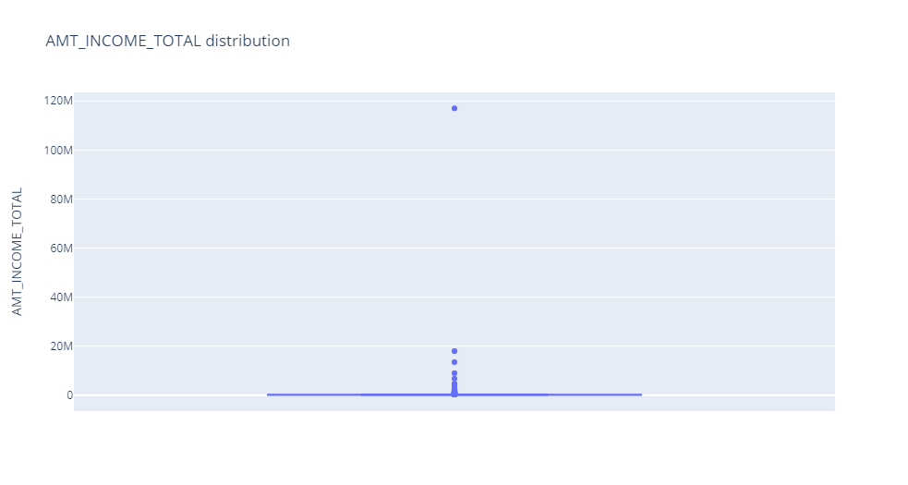
Using boxplot analysis we can plot that there is an outlier at 170M in the column "AMT_INCOME_TOTAL“

Slide 8
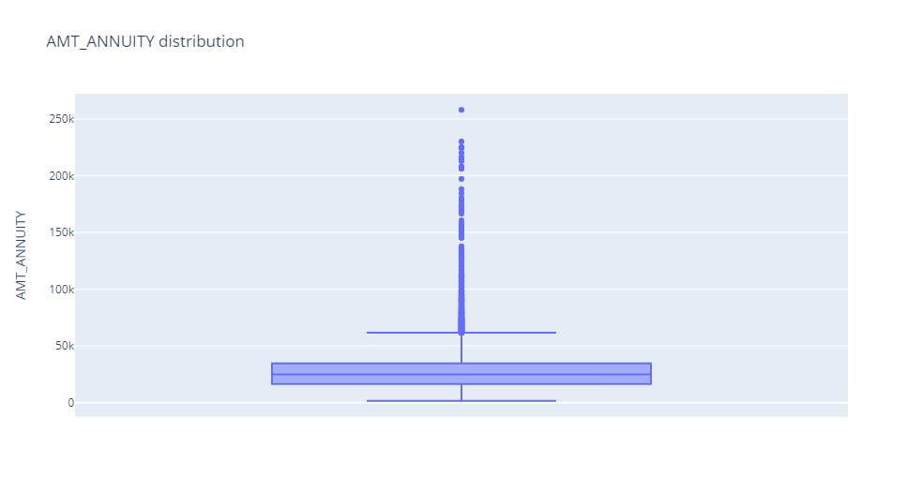
Here, we observe that the value above 258k is an outlier in the column of "AMT_ANNUUITY“

Slide 9
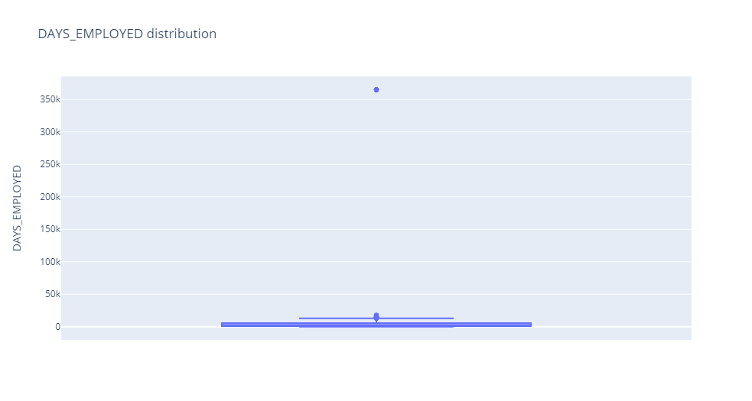
Here, we observe the column "DAYS_EMPLOYED" contains outlier which is greater than 350k

Slide 10
Distribution Check

Slide 11
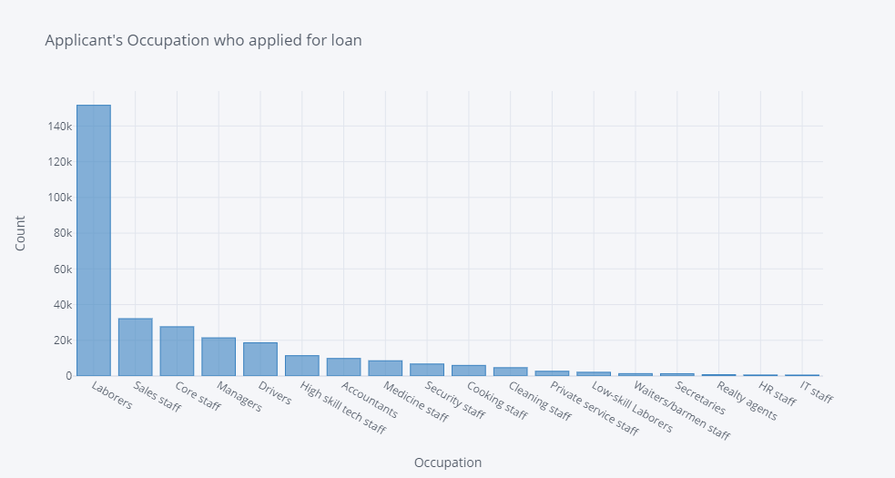
Distribution of 'OCCUPATION_TYPE'
Here, we observe that in column "OCCUPATION_TYPE" the Labourers, Sales staff, Core staff, Managers, Drivers are the highest candidates who are applying for the loan.

Slide 12
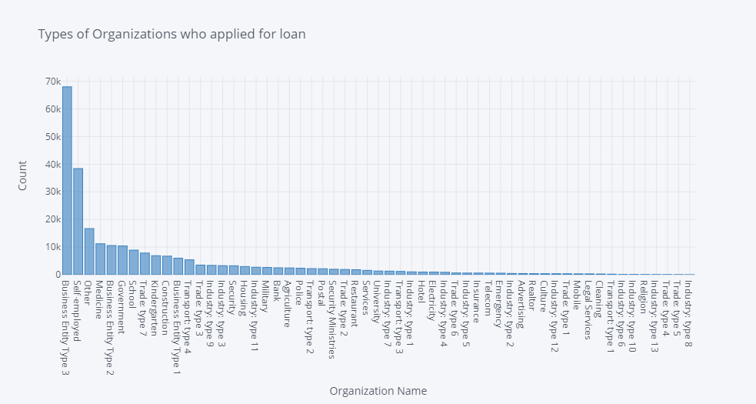
Distribution of 'ORGANIZATION_TYPE'
Here, we observe that in the "ORGANIZATION_TYPE" the majority of loan applications comes from Business Entity Type 3

Slide 13
IMBALANCE CHECK

Slide 14
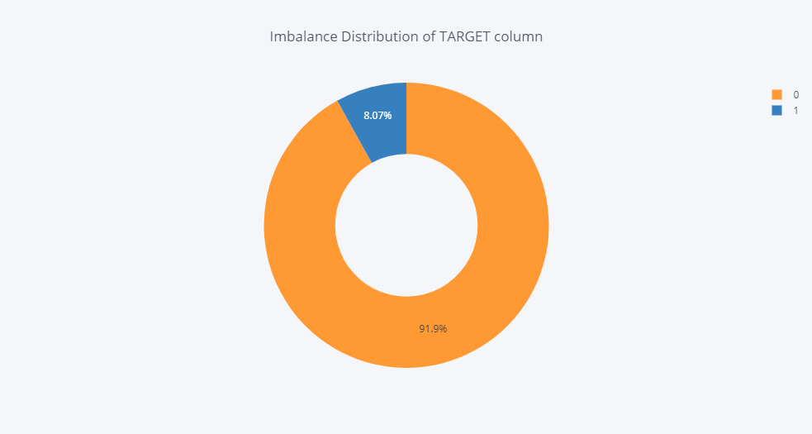
So, after analyzing this dataset we observe that there is huge imbalance in TARGET column which clearly states one side story is higher when compare to other side with 91.9% of data

Slide 15
Univariate Analysis for target 0 and 1 (Categorical Variables)

Slide 16
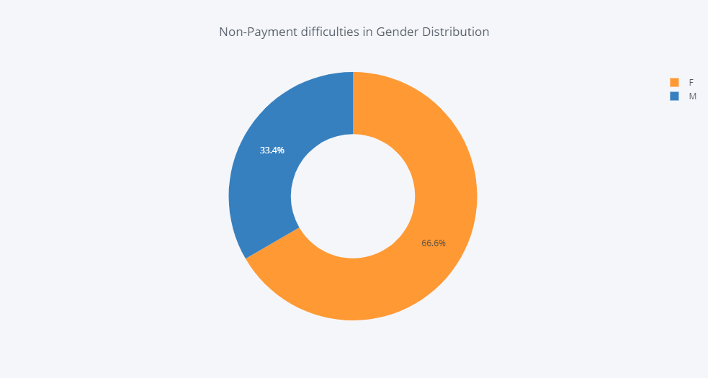
Loan Non-Payment Gender Distribution Target 0
Here, we observe that Female candidate contains higher than male in Non-Payment difficulties.

Slide 17
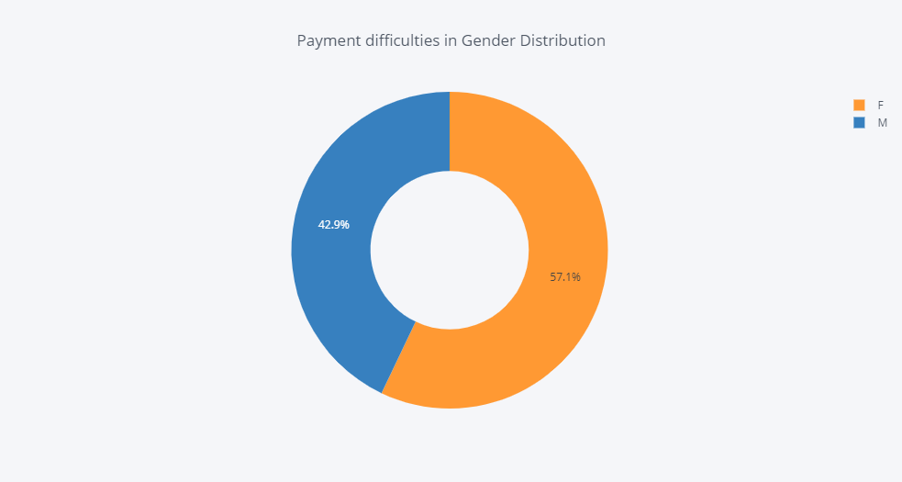
Loan Payment Gender Distribution Target 1
Here, we observe that again Female candidate contains higher than male in Payment difficulties.

Slide 18
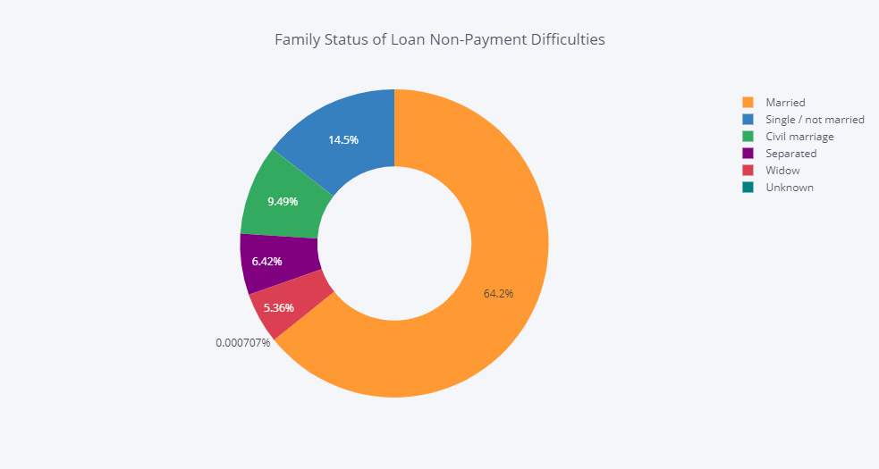
Family Status of Loan- Non Payment Difficulties Target 0
Here, we observed that in non-payment difficulties there are married candidates which is higher than other which is "Single, Civil Marriage, Seperated, Widow, Unknown".

Slide 19
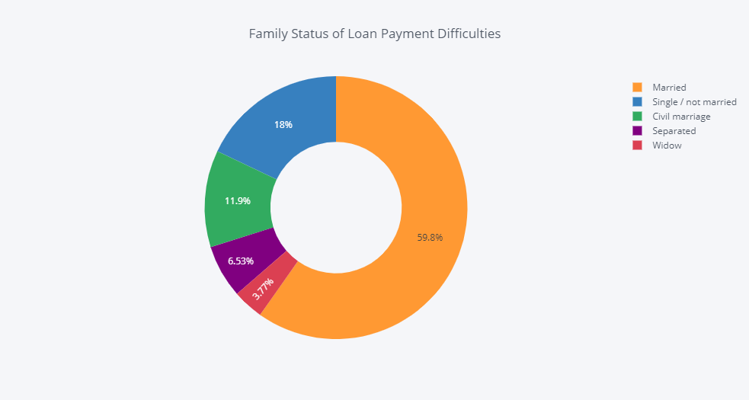
Family Status of Loan Payment Difficulties Target 1
Here, again we observed that in loan payment difficulties there are married candidates only which is higher than other which is "Single, Civil Marriage, Seperated, Widow, Unknown".

Slide 20
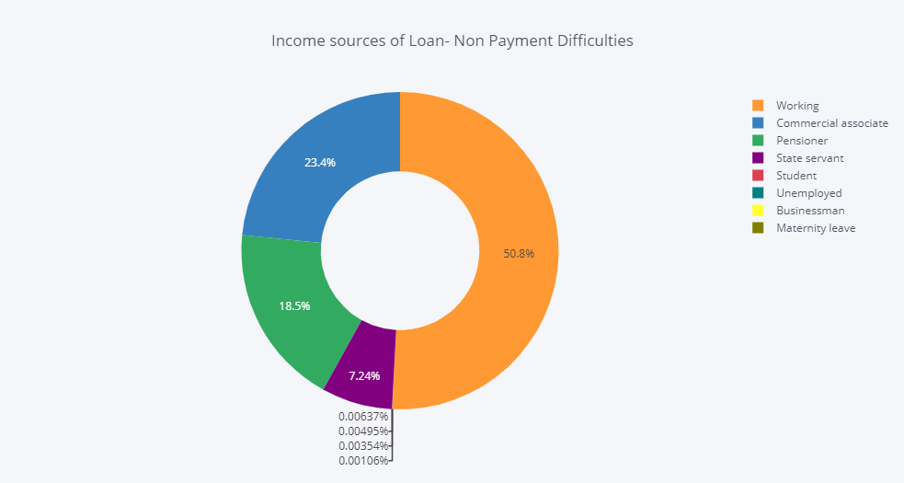
Income sources of Loan- Non Payment Difficulties Target 0
Here, we observed that Working professionals are slighlty above 50% who are facing difficulties in non-payment
[68]

Slide 21
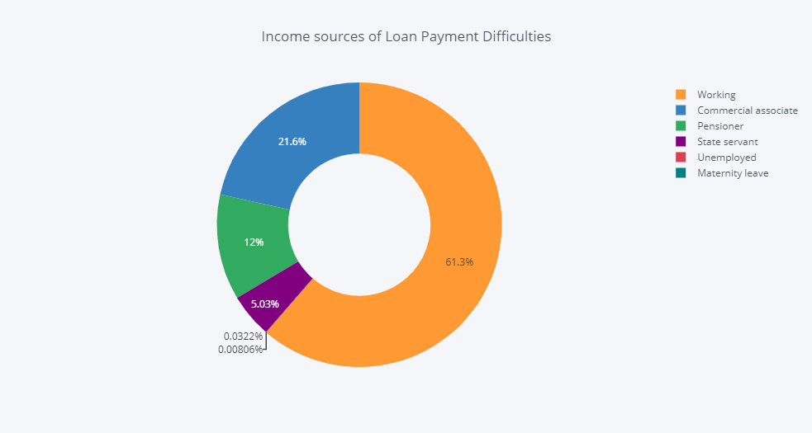
Income sources of Loan Payment Difficulties Target 1
Now, here very interesting picture comes where working professinal are much higher among others who are facing difficulties in loan payment.

Slide 22
Univariate Analysis for target 0 and 1 (Numeric Variables)

Slide 23
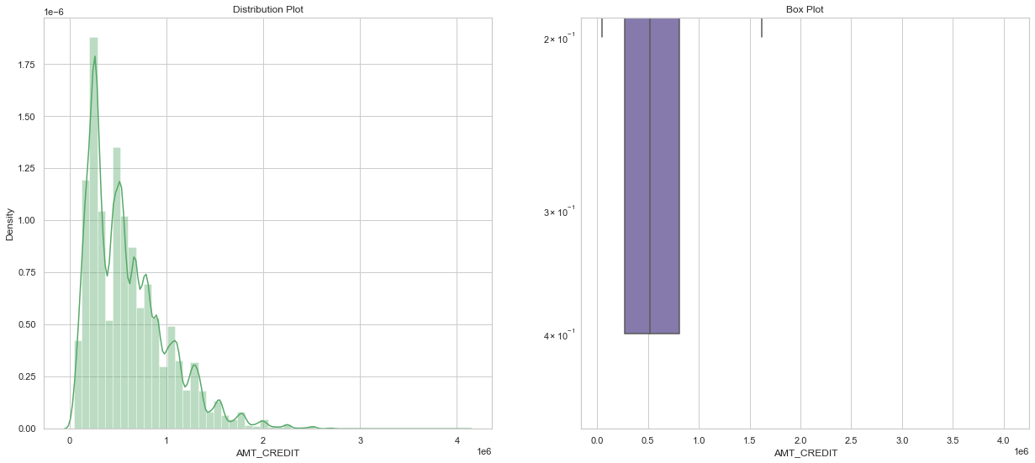
Analyzing "AMT_CREDIT" for Loan Non-Payment Difficulties Target 0
We can infer that most of the annuity amount are from first quartile. The distribution curve doen't appear as normal or bell curve.

Slide 24
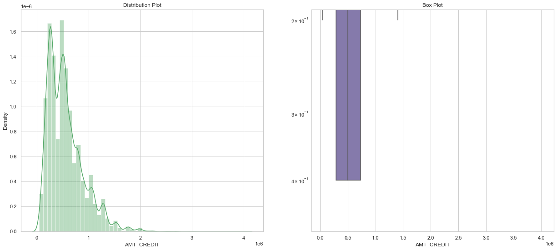
Analyzing "AMT_CREDIT" for Loan Non-Payment Difficulties Target 1
We can infer that most of the annuity amount are from first quartile. The distribution curve doesn't appear as normal or bell curve.

Slide 25
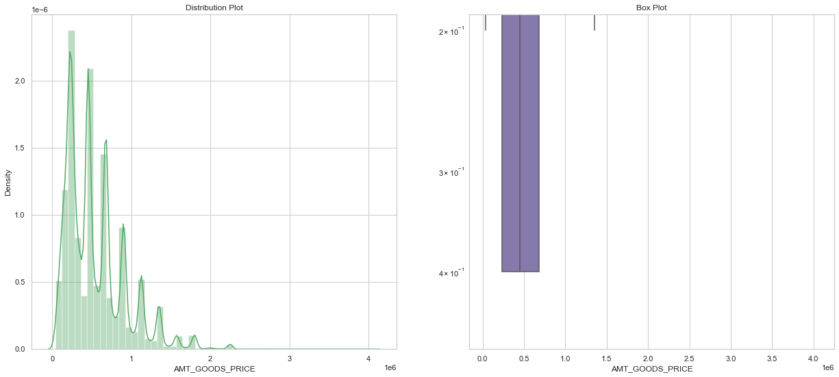
Analyzing AMT_GOODS_PRICE for Loan Non-Payment Difficulties Target 0
There are some outliers and 1st quartile is bigger than 3rd quartile, which means more are from 1st quartile.

Slide 26
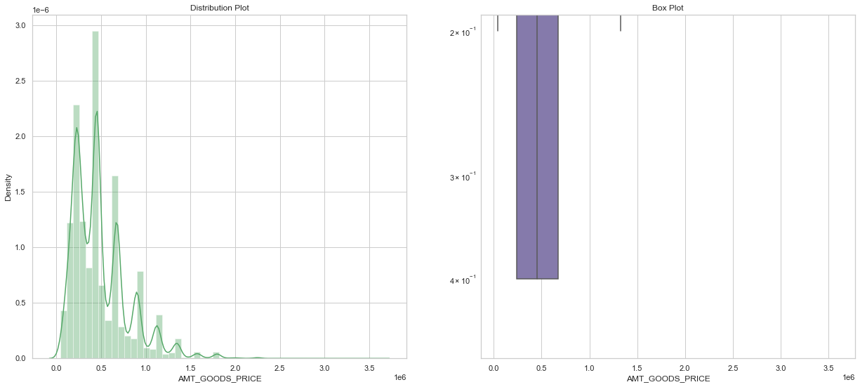
Analyzing AMT_GOODS_PRICE for Loan Non-Payment Difficulties Target 1
There are some outliers and 1st quartile is bigger than 3rd quartile, which means more are from 1st quartile.

Slide 27
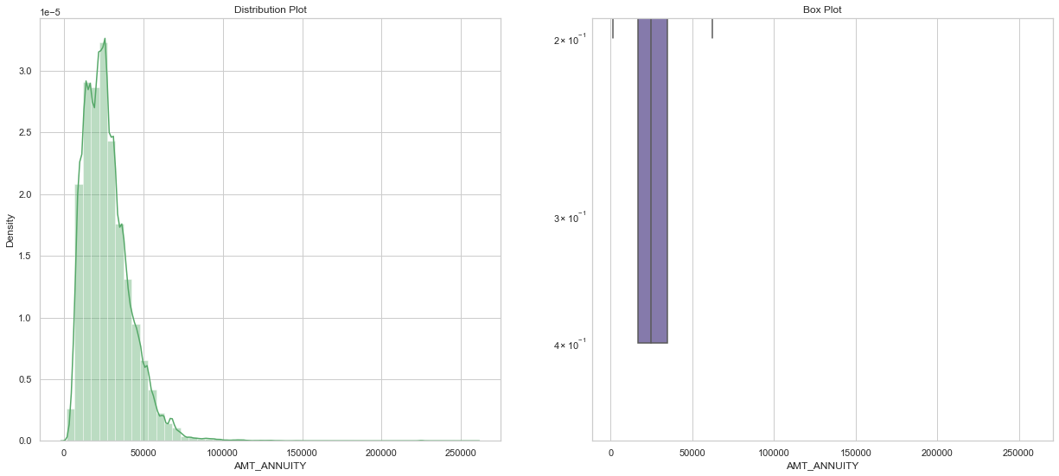
"AMT_ANNUITY“ for Loan Non-Payment Difficulties Target 0
We can infer that most of the annuity amount are from first quartile. The distribution curve doesn't appear as normal or bell curve.

Slide 28
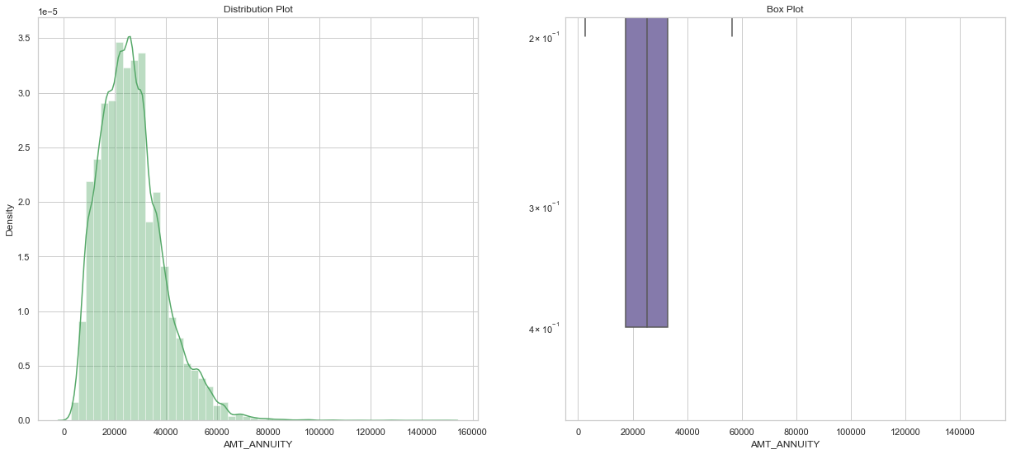
"AMT_ANNUITY“ for Loan Non-Payment Difficulties Target 1
We can infer that most of the annuity amount are from first quartile. The distribution curve doesn't appear as normal or bell curve.

Slide 29
Bivariate Analysis

Slide 30
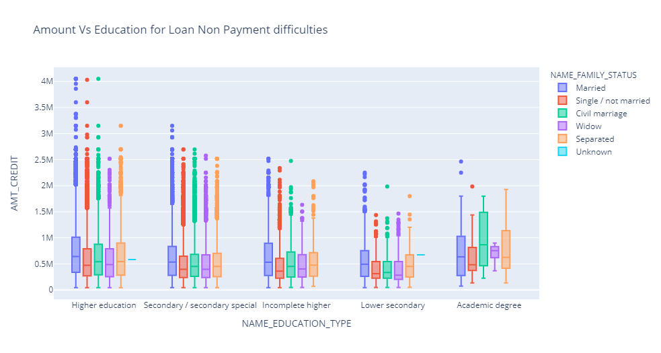
"NAME_EDUCATION_TYPE" vs "AMT_CREDIT" for loan Non Payment difficulties Target 0
Both the plots appear to be similar.
Family status of 'civil marriage', 'marriage' and 'seperated' of Academic degree education have higher number of credits.
In Education type "Higher Education" and "Secondary" have most of the outliers.

Slide 31
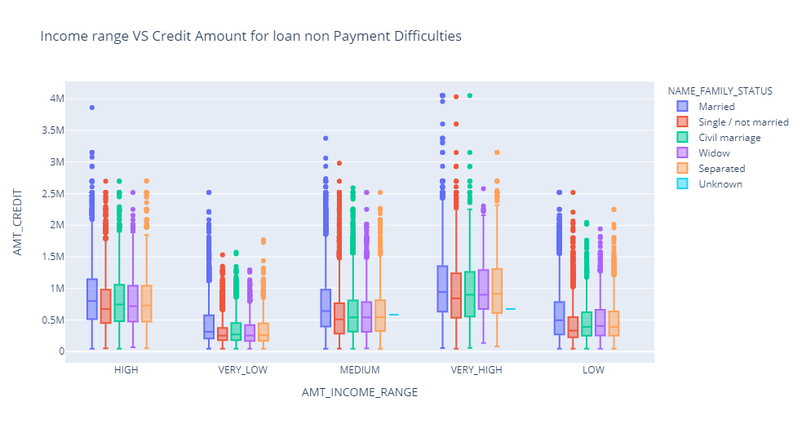
"AMT_INCOME_RANGE" vs "AMT_CREDIT" for loan non payment difficulties Target 0
Both the plots appear to be similar.
Family status of 'single', 'marriage' and 'seperated' have higher number credits

Slide 32
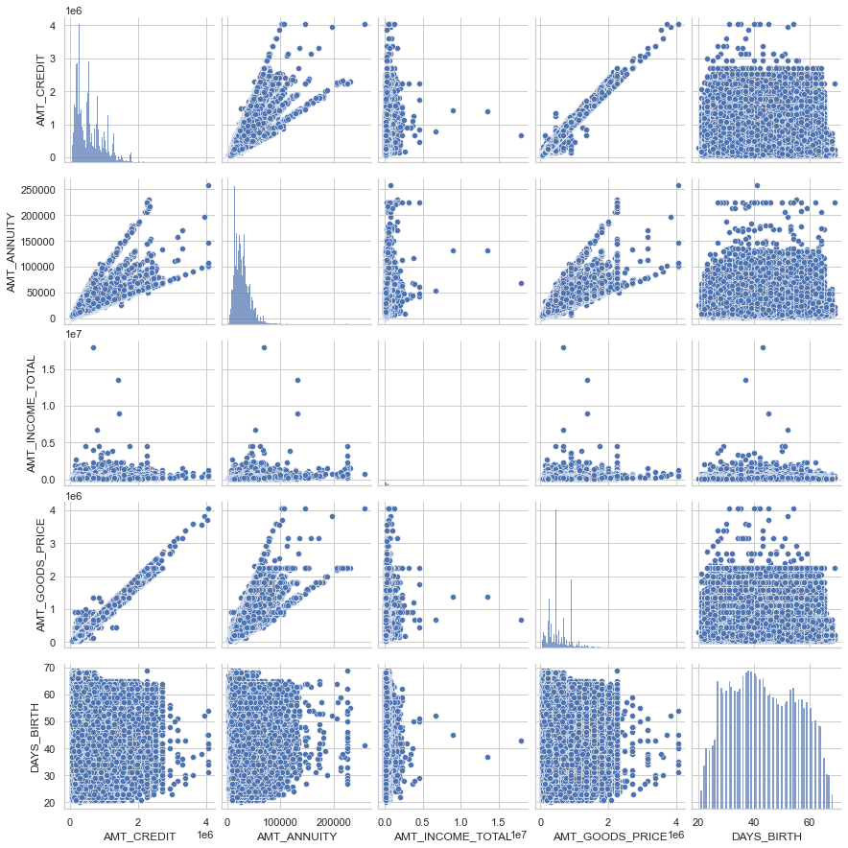
Target 0 Pair plot for loan non payment difficulties
Credit amount and goods price have higher correlation
In credit amount vs income have some deviance in Loan payment and non payment difficulties

Slide 33
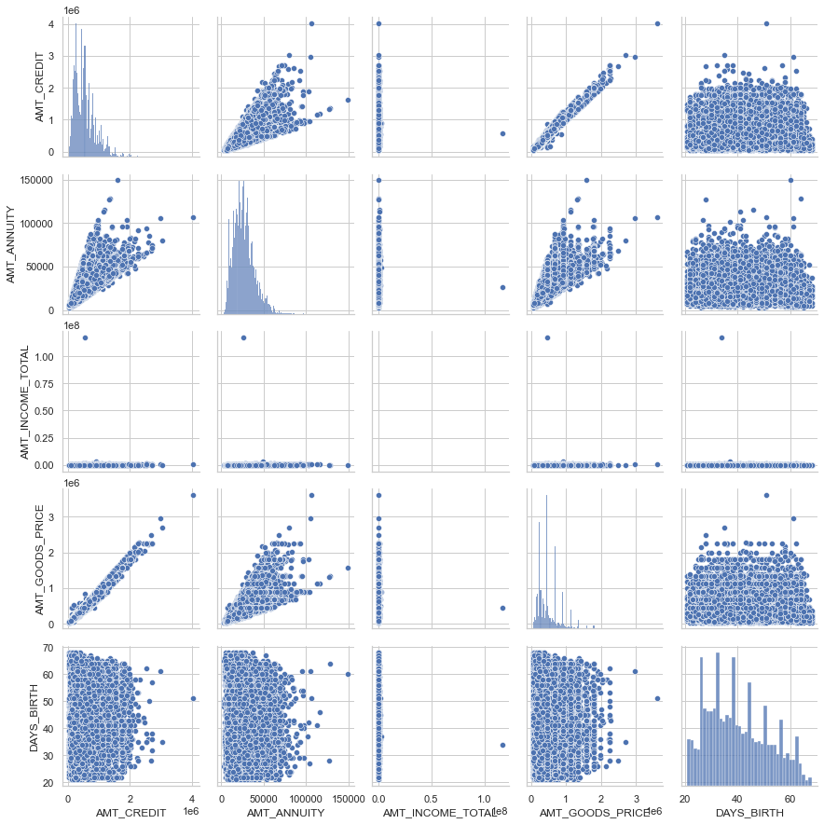
Target 1 Pair plot for loan non payment difficulties
Credit amount and goods price have higher correlation
In credit amount vs income have some deviance in Loan payment and non payment difficulties

Slide 34
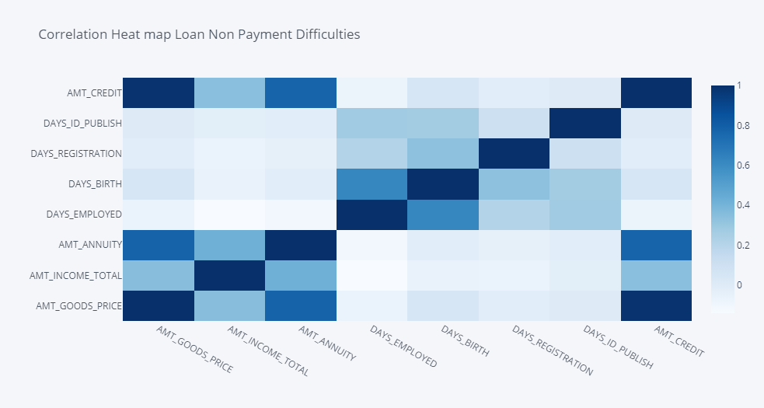
Heat Map - Loan non payment difficulties Target 0
Credit amount and goods price have higher correlation
In credit amount vs income have some deviance in Loan payment and non payment difficulties

Slide 35
previous application

Slide 36
Univariate Analysis

Slide 37
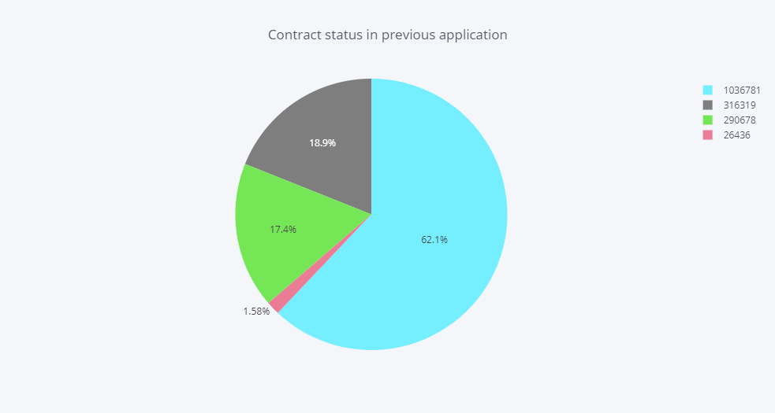
Contract status
Majority of the loans are approved and less percent are unused.

Slide 38
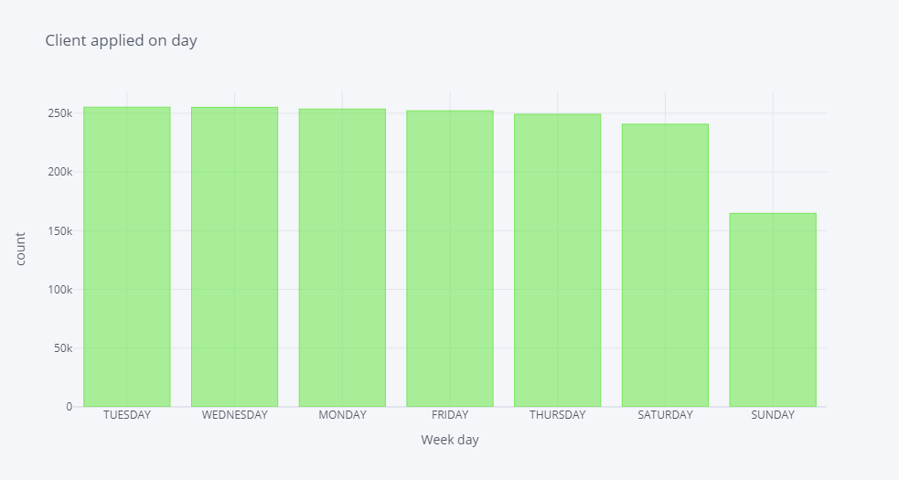
Day, when the client applied for the loan and their count
Most of the applicants apply in weekdays when compared to weekend

Slide 39
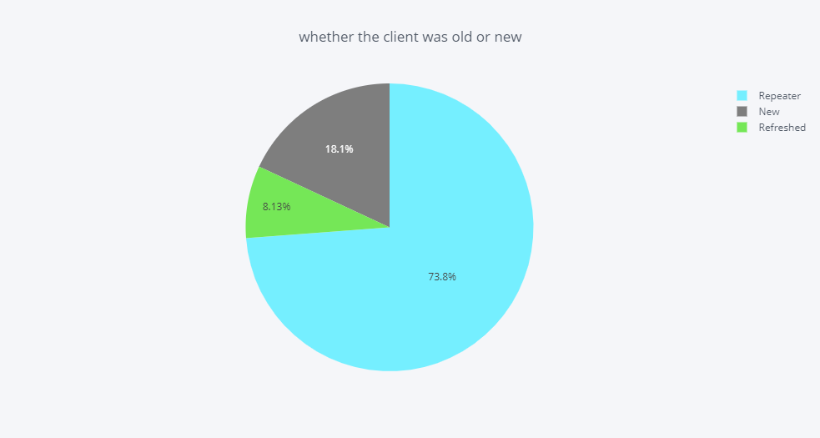
While applying whether the client was old or new
Most of the clients are repeaters.

Slide 40
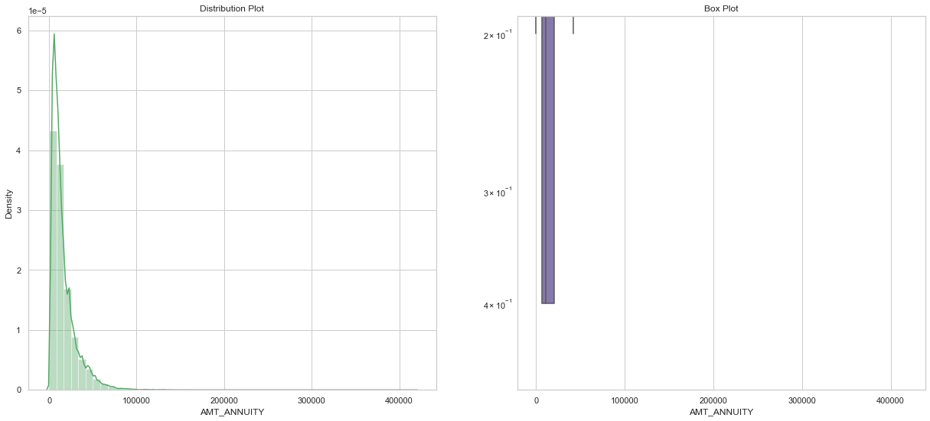
Univariate analysis on "AMT_ANNUITY"
There are some outliers and curve is not normal

Slide 41
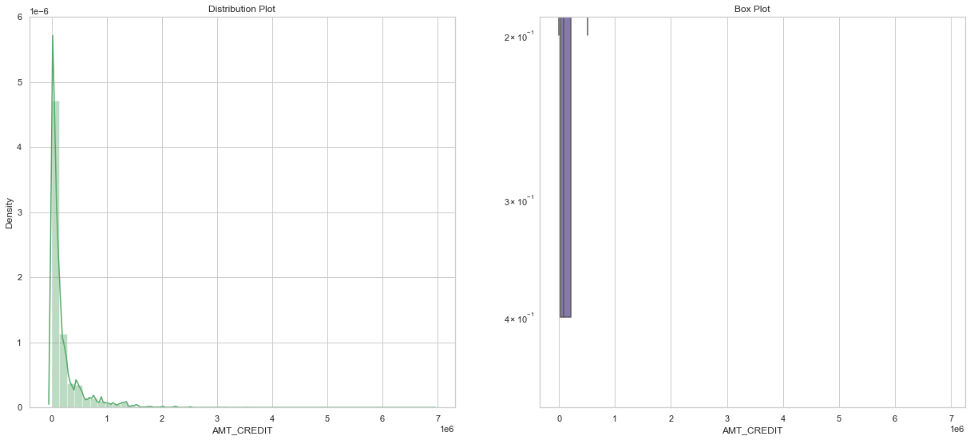
Univariate analysis on "AMT_ CREDIT”
There are some outliers and curve is not normal

Slide 42
Bivariate analysis after combining previous application and application data

Slide 43
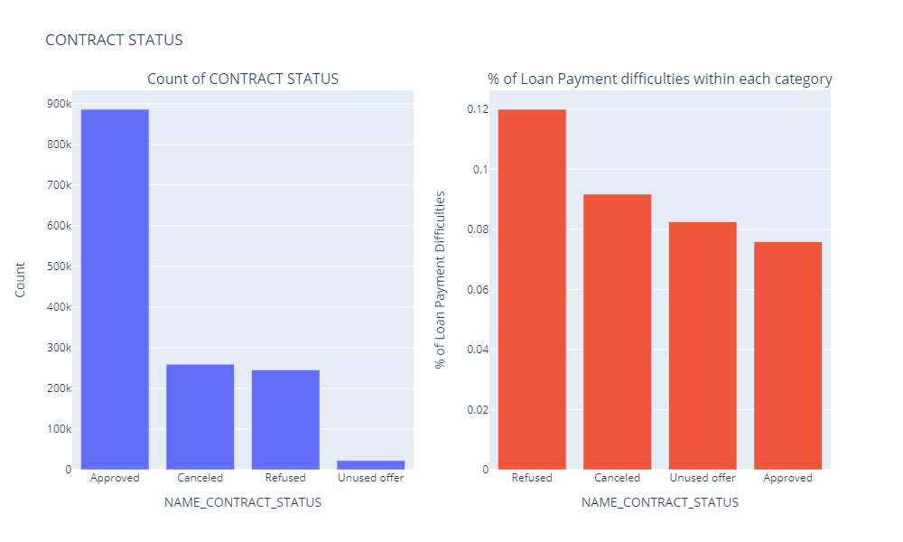
Contract status and its category distribution with maximum % of loan payment difficulties.
From first plot most contracts from previous application has been approved
From second plot
'Refused' are one with maximum % of loan payment Difficulties from current application.
'Approved' are one with minimum % of loan payment Difficulties from current application.

Slide 44
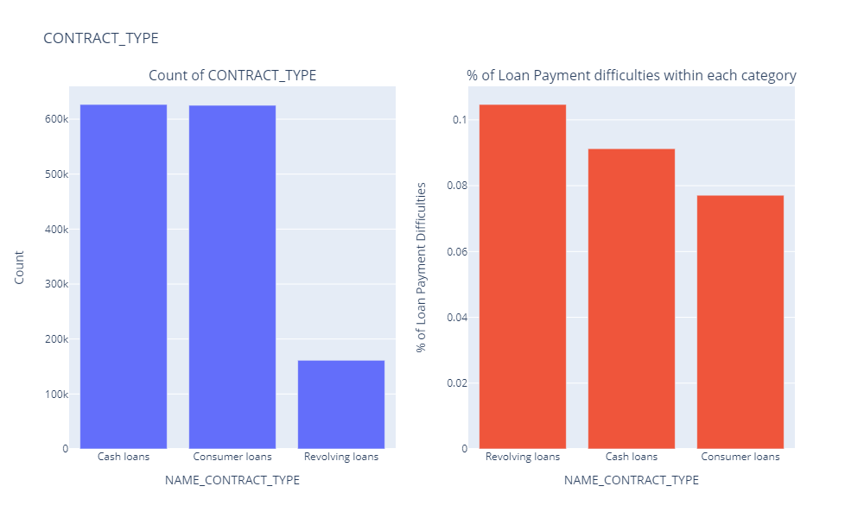
Contract type and its category distribution with maximum % of loan payment difficulties.
From first plot it can be seen most contract type were of "cash loan" from previous application
From second plot
'Revolving Loans' are one with maximum % of loan payment Difficulties from current application.
'Consumer Loans' are one with minimum % of loan payment Difficulties from current application.

Slide 45
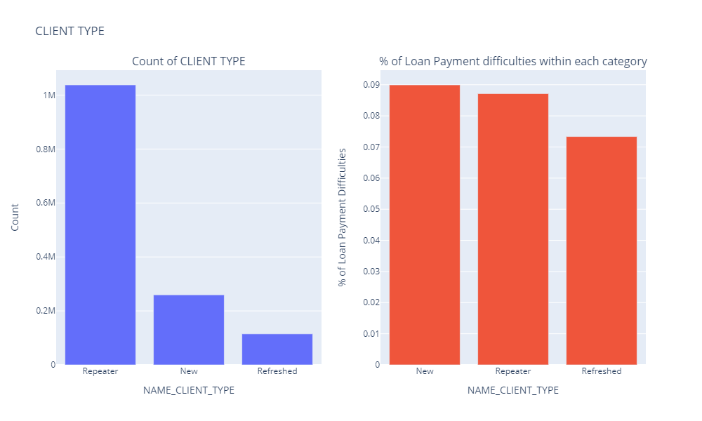
Client type and its category distribution with maximum % of loan payment Difficulties.
First graph shows most of the clients are "Repeater"
Second graph shows
"New" clients have maximum % of loan payment Difficulties from current application
"Refreshed" clients have minimum % of loan payment Difficulties from current application

Slide 46
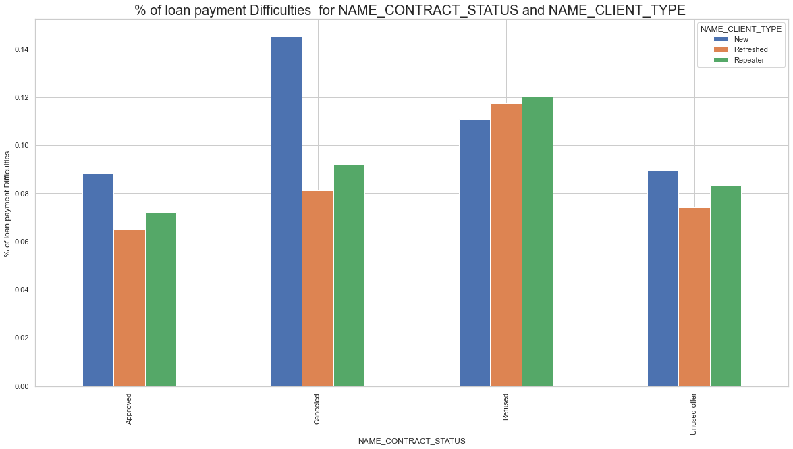
% of loan payment Difficulties in NAME_CONTRACT_STATUS and NAME_CLIENT_TYPE "
Client who are "New" and have "Cancelled" previous application have more % of loan payment Difficulties in current application

Slide 47
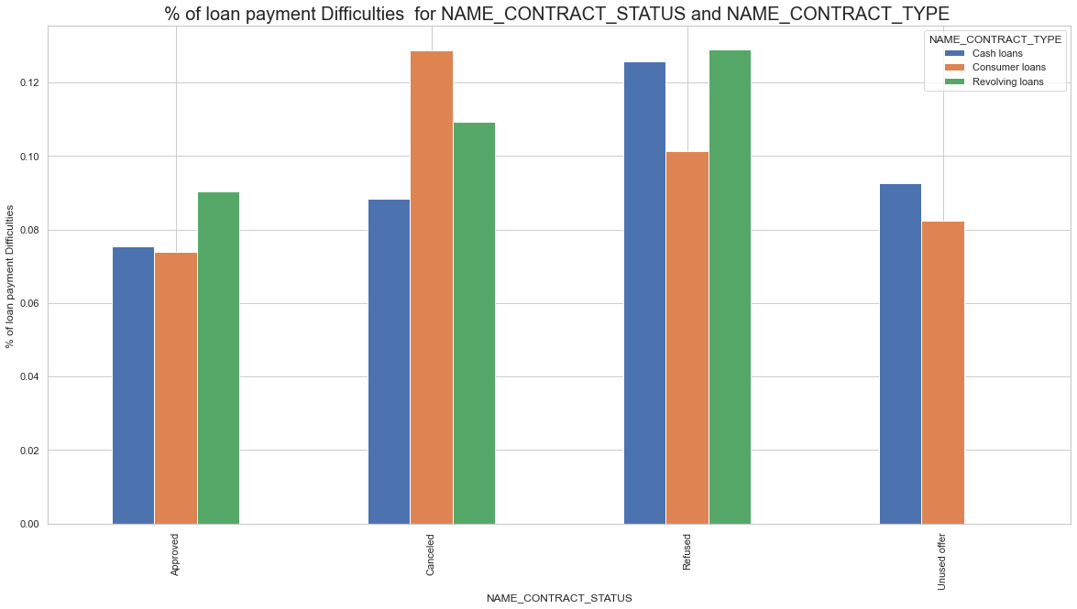
"% of loan payment Difficulties for NAME_CONTRACT_STATUS and NAME_CONTRACT_TYPE "
Clients with 'Revolving loans' and "Refused" previous application tend to have more % of Loan Payment difficulties in current application.

Slide 48
Conclusion

Slide 49
Loan Defaulters
Loan defaulters were
- "Maternity leave" clients in ‘NAME_INCOME_TYPE’
- "Low skilled Laborers" clients in ‘OCCUPATION_TYPE’
- "Lower Secondary " clients in ‘NAME_EDUCATION_TYPE’
Because their count is comparatively less and also have maximum % of loan payment Difficulties in Application data
Loan defaulters were from the counts which are comparatively less in
"Refusal " from "NAME_CASH_LOAN_PURPOSE"
"Refused " from ‘NAME_CONTRACT_STATUS’
"Revolving Loans" from ‘NAME_CONTRACT_TYPE" and they have maximum % of loan payment difficulties around 23%, 12% and 10% respectively from Previous Application data.
Clients with "Revolving Loans" with "Refused" previous application tend to have more % of payment difficulties in current application. As their counts are comparatively less they were driving factors for Loan Defaulters

Slide 50
Amortized Loan
Loan Approval should be focused more on “CONTRACT_TYPE” as “Student”, “Pensioner ” and “Businessman” with “HOUSING_TYPE ” other than “Co-Op Apartment” for successful payment.
Loans can be approved for “HOUSING_TYPE” with Parents as they have successfully settled the loan.

Slide 51
Thank you

